Slide 1
Online Purchasing Behaviour Prediction
David Wang
501208639
Tamer Abdou, Ph.D.

Slide 2
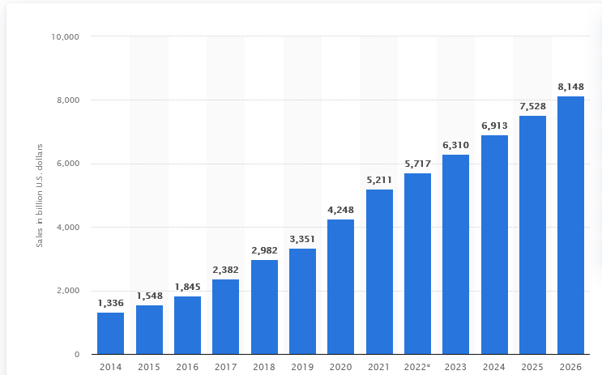
Background & Objective
E-commerce and online shopping continues to grow to become a greater part of our lives
There is a large upside in being able to know more about consumers and their behaviours
Dataset contains data about consumer clickstream activity, background information, time-related data
Goal is to create and train a
model which will be able to
predict behaviours that lead
to successful purchases

Slide 3
Methodology
Data Balancing/ Sampling
Feature Selection Methods
Data Scaling Methods
Cross
validation
Methods
Model tuning/ additional metrics
PCA Applications

Slide 4
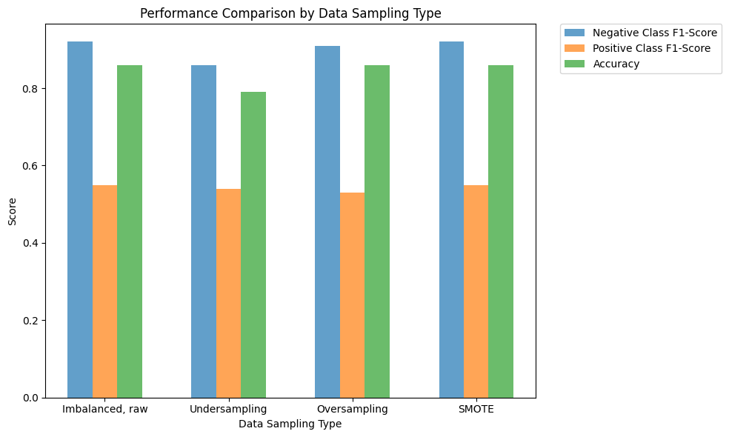
Results - Data Balancing/ Sampling
Data Sampling Technique | Time (s) | Memory (MiB)
Imbalanced, raw | 0.046875 | 209.79
Undersampling | 0.015625 | 209.77
Oversampling | 0.078125 | 209.77
SMOTE | 0.109375 | 210.83

Slide 5
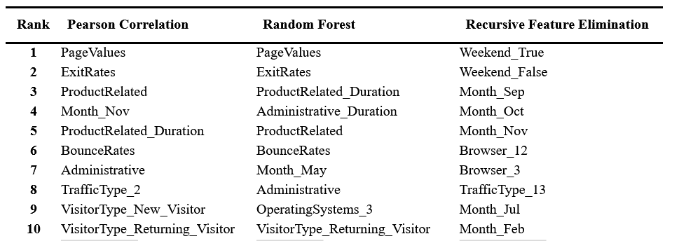
Results - Feature Selection (cont.)
Feature Selection Technique | Time (s) | Memory (MiB)
Control (75) | 1.041875 | 254.78
Pearson’s Correlation (18) | 0.583333 | 215.26
Random Forest (19) | 1.005208 | 244.64
Recursive Feature Elimination (20) | 0.526042 | 258.26
Notes:
Features kept - we see that both Pearson Correlation methods and Random Forest methods keep similar features
Time/memory efficiency - these are the results of using the each feature selection method in all decision tree, random forest and logistic regression models

Slide 6
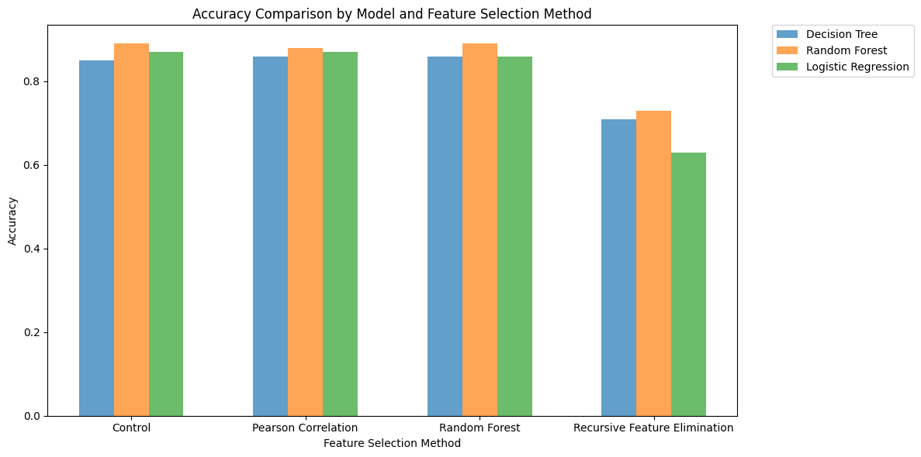
Results - Feature Selection

Slide 7
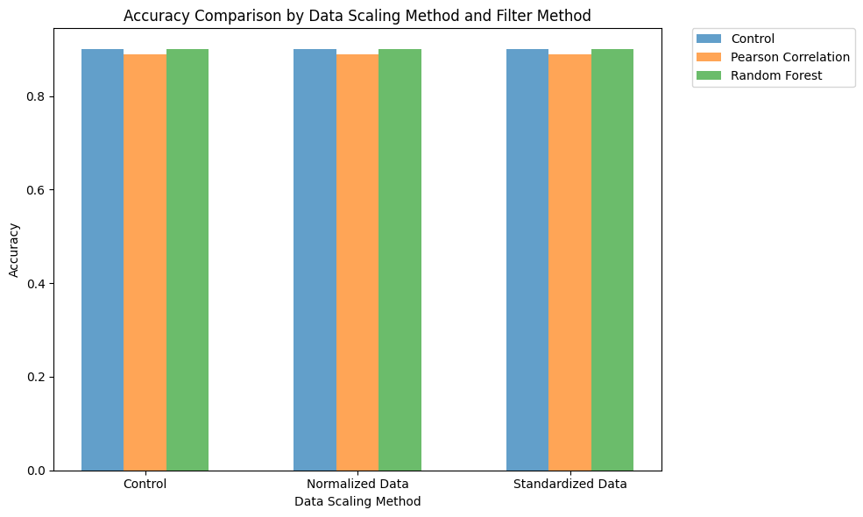
Results - Data Balancing
Data Scaling Technique | Time (s) | Memory (MiB)
Control | 1.307291 | 254.78
Normalization | 1.586775 | 263.51
Standardization | 1.473958 | 264.10

Slide 8
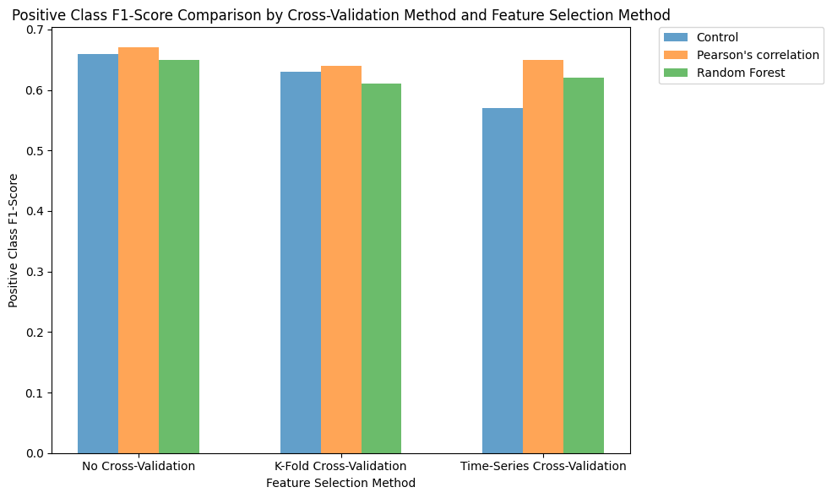
Results - Cross-validation
Method | Time (s) | Memory (MiB)
Control, P corr | 2.390625 | 273.88
K-Fold, P corr | 6.015625 | 256.45
Time Series, Pcorr | 6.5 | 263.99

Slide 9
Results - Model Tuning
Pearson Correlation Filter/ No Cross-Validation
Number of Estimators | Accuracy | Time (s) | Memory (MiB)
100 | 0.89 | 2.453125 | 235.53
500 | 0.89 | 10.265625 | 1494.98
1000 | 0.89 | 16.625 | 396.10
Pearson Correlation Filter/ K-Fold Cross Validation
Number of Estimators | Accuracy | Time (s) | Memory (MiB)
100 | 0.90 | 10.203125 | 1291.79
500 | 0.90 | 36.625 | 1332.65
1000 | 0.90 | 69.03125 | 1380.50
Pearson Correlation Filter/ Time-Series Cross Validation
Number of Estimators | Accuracy | Time (s) | Memory (MiB)
100 | 0.90 | 7.359375 | 1302.00
500 | 0.90 | 22.8125 | 1367.62
1000 | 0.90 | 44.0625 | 1414.58
Pearson Correlation Filter/ K-Fold Cross Validation
Number of Folds | Accuracy | Time (s) | Memory (MiB)
5 | 0.90 | 10.203125 | 1291.79
10 | 0.90 | 23.953125 | 1328.65
50 | 0.90 | 169.09375 | 1333.60
Pearson Correlation Filter/ Time-Series Cross Validation
Number of Folds | Accuracy | Time (s) | Memory (MiB)
5 | 0.90 | 7.359375 | 1302.00
10 | 0.90 | 13.703125 | 1325.43
50 | 0.90 | 69.0625 | 1323.23

Slide 10
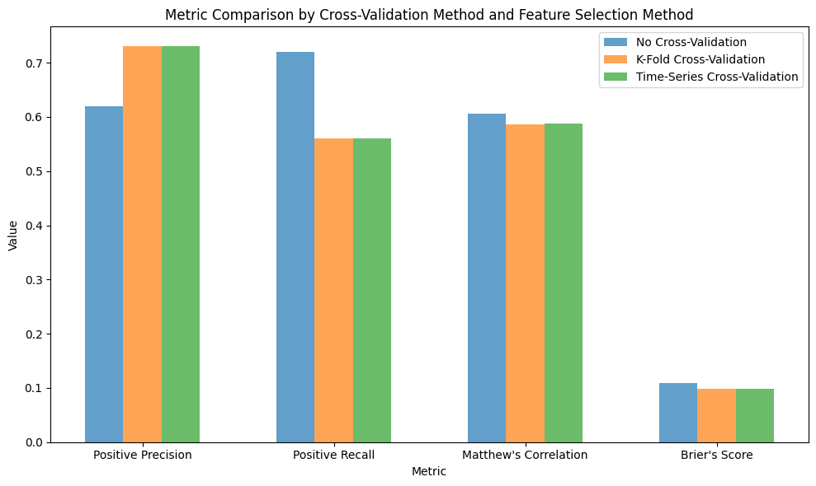
Results - Additional Metrics

Slide 11
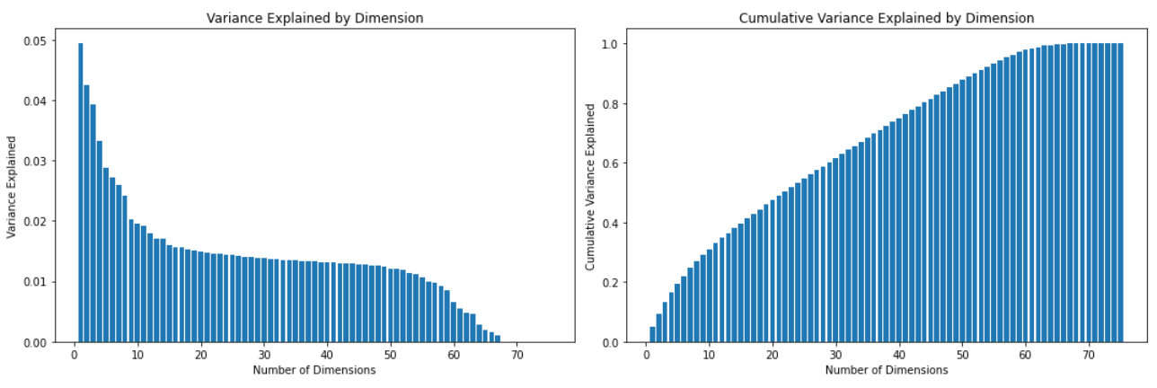
Results - PCA
Metric | Pearson corr. features (No CV) | 18 Principal Components | 75 Principal Components | Hybrid Approach (18 Features + 57 PCs)
Negative F1-Score | 0.94 | 0.88 | 0.92 | 0.94
Process F1-Score | 0.67 | 0.42 | 0.53 | 0.63
Accuracy | 0.89 | 0.80 | 0.87 | 0.89
Matthew’s Correlation | 0.6054 | 0.2961 | 0.4596 | 0.5645
Brier’s Score | 0.1084 | 0.1998 | 0.1346 | 0.1084
Time (S) | 2.515625 | 6.234375 | 10.109375 | 7.75
Memory (MiB) | 235.11 | 244.49 | 260.63 | 299.48

Slide 12
Conclusion
Developed a Random Forest model using SMOTE oversampling, data standardization, and Pearson’s correlation
Model that was able to predict comparably well to literature
Using methods that require less computing resources/ training time
Was able to experiment using methods such as cross-validation, PCA
Can use the model to make certain suggestions to website designers, product marketers, etc.
Limitations of model and computing resources
Notes:
summary of research questions
techniques used
conclusions
limitations and next steps

Slide 13
References
Baati, K., & Mohsil, M. (2020, May 6). Real-time prediction of online shoppers’ purchasing intention using Random Forest. Artificial Intelligence Applications and Innovations: 16th IFIP WG 12.5 International Conference, AIAI 2020, Neos Marmaras, Greece, June 5–7, 2020, Proceedings, Part I. https://www.ncbi.nlm.nih.gov/pmc/articles/PMC7256375/
Diamantaras, K., Salampasis, M., Katsalis, A., & Christantonis, K. (2021, January). Predicting shopping intent of e-commerce users using LSTM recurrent ... Predicting Shopping Intent of e-Commerce Users using LSTM Recurrent Neural Networks. https://www.researchgate.net/publication/353397684_Predicting_Shopping_Intent_of_e-Commerce_Users_using_LSTM_Recurrent_Neural_Networks
Sakar, C. O., & Kastro, Y. (n.d.). Online Shoppers Purchasing Intention Dataset Data Set. UCI Machine Learning Repository: Online Shoppers Purchasing Intention Dataset Data set. https://archive.ics.uci.edu/ml/datasets/Online+Shoppers+Purchasing+Intention+Dataset
Sakar, C. O., Polat, S. O., Katircioglu, M., & Kastro, Y. (2018, May 9). Real-time prediction of online shoppers’ purchasing intention using Multilayer Perceptron and LSTM recurrent neural networks - neural computing and applications. SpringerLink. https://link.springer.com/article/10.1007/s00521-018-3523-0
Zanzana, S., & Martin, J. (2023, February 21). Retail e-commerce and COVID-19: How online sales evolved as in-person shopping resumed. https://www150.statcan.gc.ca/n1/pub/11-621-m/11-621-m2023002-eng.htm

Slide 14
Questions

